Slide 1
Planning for security

Slide 2
Information Security Policy, Standards, and Practices
Policy: a plan or course of action that conveys instructions from an organization’s senior management to those who perform duties
Standards: are more detailed statements of what must be done to comply with policy
For a policy to be effective it must be disseminated, review, understood and agreed by all members of organization and uniformly enforced
Security policy: depends on the context in which it is used national security, communication security
An information security policy: provides rules for the protection of the information assets of the organization

Slide 3
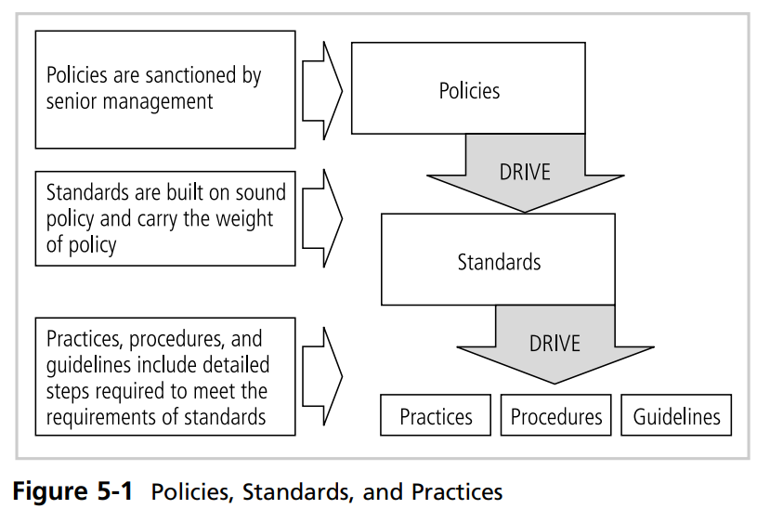
Policies, Standards, and Practices

Slide 4
National Institute of Standards and Technology’s(NIST)
National Institute of Standards and Technology’s define three types of security policy
Enterprise information security policies (EISP)
Issue-specific security policies (ISSP)
Systems-specific security policies (SysSP)

Slide 5
Enterprise Information Security Policy (EISP) OSP,ISP
The EISP is based on the mission, vision, and direction of the organization
The EISP guides the development, implementation, and management of the security program
The EISP is an executive level document, usually drafted by or in cooperation with the chief information officer(CIO) of the organization
It defines the purpose, scope, constraints, and applicability of the security program

Slide 6
Enterprise Information Security Policy (EISP)
According to (NIST), the EISP typically addresses compliance in the following two areas:
Ensure meeting the requirements to establish a program and the responsibilities assigned therein to various organizational components
The use of specified penalties and disciplinary action

Slide 7
EISP Elements
An overview of the corporate philosophy on security
Information on the structure of the information security organization and individuals who fulfill the information security role
Fully articulated responsibilities for security that are shared by all members of the organization (employees, contractors, consultants, partners, and visitors)
Fully articulated responsibilities for security that are unique to each role within the organization

Slide 8
Components of the EISP
Statement of Purpose: Answers the question, “What is this policy for?” Provides a framework that helps the reader to understand the intent of the document.
Identify the elements of a good security policy
Explain the need for information security
Specify the various categories of information security
Identify the information security responsibilities and roles
Identify appropriate levels of security through standards and guidelines

Slide 9
Components of the EISP
Information Security Elements: Defines information security.
For example: “Protecting the confidentiality, integrity, and availability of information while in processing, transmission, and storage, through the use of policy, education and training, and technology
Need for Information Security:
Provides information on the importance of information security in the organization and the obligation (legal and ethical) to protect critical information, whether regarding customers, employees, or markets
Information Security Responsibilities and Roles:
Defines the organizational structure designed to support information security within the organization. Identifies categories of individuals with responsibility for information security (IT department, management, users) and their information security responsibilities, including maintenance of this document

Slide 10
Issue-Specific Security Policy (ISSP)
The ISSP:
addresses specific areas of technology (one issue)
requires frequent updates
contains a statement on the organization’s position on a specific issue(attack)
An ISSP may cover the following topics:
E-mail
Use of the Internet
Specific minimum configurations of computers to defend against worms and viruses
Prohibitions against hacking or testing organization security controls
Home use of company-owned computer equipment
Use of personal equipment on company networks
Use of telecommunications technologies (fax and phone)
Use of photocopy equipment

Slide 11
Approaches for creating and managing ISSPs
Independent ISSP documents, each tailored to a specific issue
A single comprehensive ISSP document covering all issues
A modular ISSP document that unifies policy creation and administration, while maintaining each specific issue’s requirements

Slide 12
Components of An ISSP
Statement of policy
Scope and applicability
Definition of technology addressed
Responsibilities
Authorized access and usage of equipment
User access
Fair and responsible use
Protection of privacy
Prohibited usage of equipment
Disruptive use or misuse
Criminal use
Offensive or harassing materials
Copyrighted, licensed

Slide 13
Components of An ISSP
Systems management
Management of stored materials
Virus protection
Physical security
Encryption
Violations of policy
Procedures for reporting violations
Penalties for violations
Policy review and modification
Scheduled review of policy procedures for modification
Legal disclaimers
Limitations of liability
Statements of liability
Other disclaimers as needed

Slide 14
Systems-Specific Policy (SysSP)
SysSPs often function as standards or procedures to be used when configuring or maintaining systems.
For example, a SysSP might describe the configuration and operation of a network firewall. This document could include a statement of managerial intent; guidance to network engineers on the selection, configuration, and operation of firewalls; and an access control list that defines levels of access for each authorized user.
SysSPs can be separated into two general groups,
managerial guidance
technical specifications

Slide 15
Managerial Guidance SysSPs
Managerial Guidance SysSPs :document is created by management to guide the implementation and configuration of technology as well as to address the behavior of people in the organization in ways that support the security of information.
management can craft a policy informing users what they can do with the technology and how they are supposed to do it, it might be necessary for system administrators to configure and operate the system.

Slide 16
Technical Specifications SysSPs
There are two general methods of implementing such technical controls:
Access Control Lists
Who can use the system
What authorized users can access
When authorized users can access the system
Where authorized users can access the system from
Configuration Rule Policies
specific instructions that govern how a security system reacts to the data it receives
Many security systems, for example firewalls, intrusion detection and prevention systems (IDPSs), and proxy servers, use specific configuration scripts that represent the configuration rule policy to determine how the system handles each data element they process.

Slide 17
Policy Management
Policies must be managed as they constantly change
To remain visible, security policy must have:
Responsible individual (policy administrator, creation, revision, distribution)
Schedule of reviews (effective)
Reviews procedures and practices (feedback)

Slide 18
Information Security Blueprint
basis for the design, selection, and implementation of all security program elements including policy implementation, risk management programs, education and training programs, technological controls, and maintenance of the security program
Should specify task and the order in which they are to be accomplished
Should serve as scalable, upgradeable, comprehensive plan to meet the organization’s current and future information security needs

Slide 19
The International Organization for Standardization(ISO) 27000 Series
Framework for information security that states organizational policy is needed to provide management direction and support
Provides a basis for developing organizational security
Notes:
Widely used security model

Slide 20
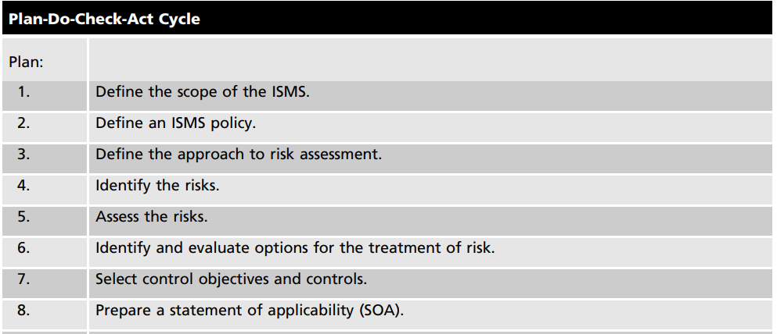
ISO/IEC 27001:2005: The Information Security Management System
Notes:
Identify, access and control ,

Slide 21
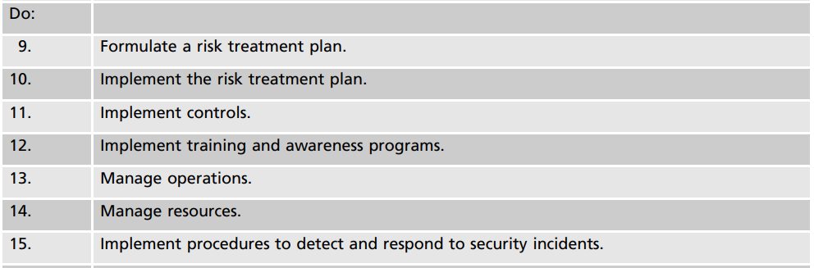
ISO/IEC 27001:2005: The Information Security Management System

Slide 22
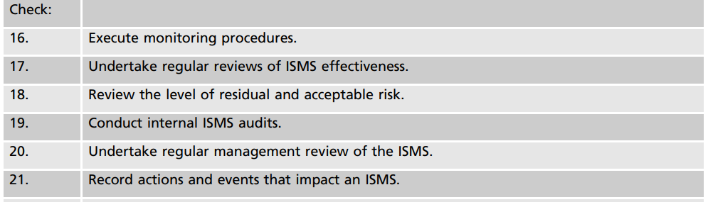
Information security management system (ISMS)

Slide 23
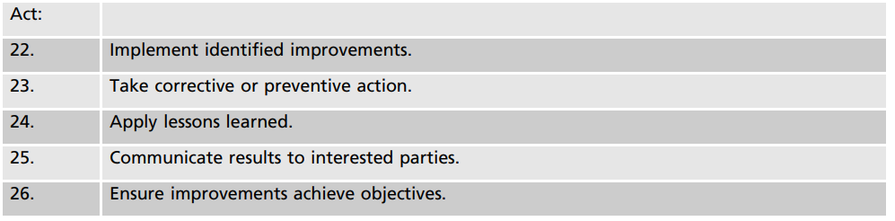
Information security management system (ISMS)

Slide 24
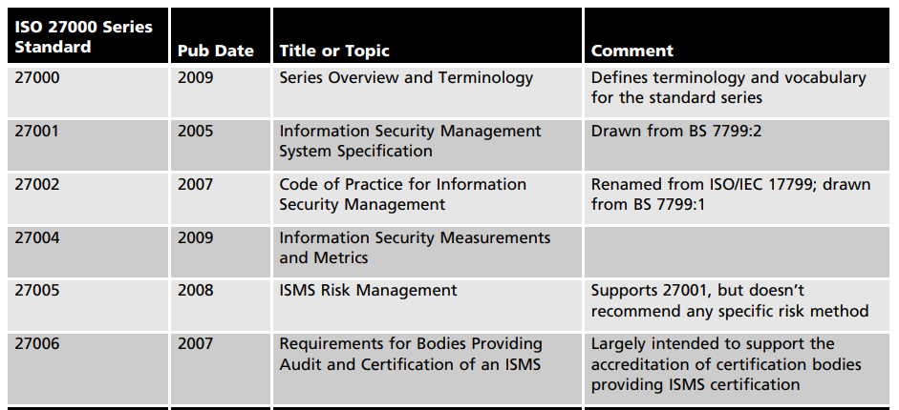
Information security management system (ISMS)

Slide 25
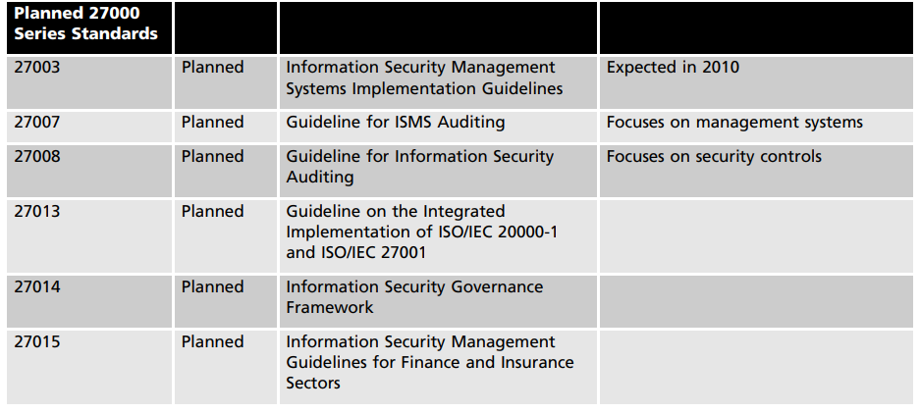
Information security management system (ISMS)

Slide 26
Internet Society and the Internet Engineering Task Force(IETF)
The Security Area Working Group acts as an advisory board for the protocols and areas developed and promoted by the IETF
security policies, security technical architecture, security services, and security incident handling
Notes:
Define the specific protocols required for solving a specific problem

Slide 27
Design of Security Architecture
Spheres of security: Foundation of security framework
Levels of control
Management control: security processes that are designed by strategic planners and implemented by the security administration of the organization
Operational controls: are management and lower-level planning functions that deal with the operational functionality of security in the organization, such as disaster recovery and incident response planning
Technical controls: are the tactical and technical implementations of security in the organization

Slide 28
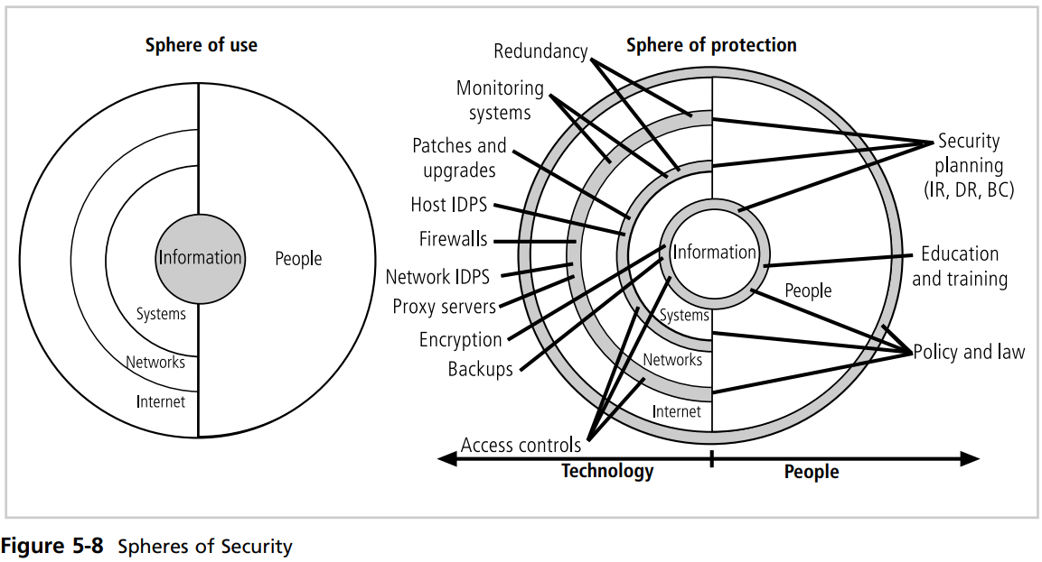
Design of Security Architecture
Spheres of Security:
Notes:
Information security is designed and implemented in three layers: policies, people (education, training, and awareness programs), and technology, commonly referred to as PPT. Each of the layers contains controls and safeguards that protect the information and information system assets that the organization values.

Slide 29
Design of Security Architecture
Information most important asset in this model, is at the center of the sphere. Information is always at risk from attacks whenever it is accessible by people or computer systems.
Networks and the Internet are indirect threats, as exemplified by the fact that a person attempting to access information from the Internet must traverse local networks
A variety of controls can be used to protect the information
Information security is designed and implemented in three layers: policies, people (education, training, and awareness programs), and technology, commonly referred to as PPT. Each of the layers contains controls and safeguards that protect the information and information system assets that the organization values.

Slide 30
Design of Security Architecture
an organization must establish multiple layers of security controls and safeguards, which can be organized into policy, training and education, and technology
policy itself may not prevent attacks, it certainly prepares the organization to handle them
training and education, which can provide some defense against attacks enabled by employee ignorance and social engineering
defense in depth: Implementation of security in layers, require the organization to establish sufficient security controls
Security Perimeter: point at which on organization security protection ends and outside world begins
Does not apply to internal attack from employees and on site physical threats
A security perimeter is the level of security that protects all internal systems from outside threats

Slide 31
components of the security perimeter
Firewalls: A firewall is a device that selectively discriminates against information flowing into or out of the organization, prevents unauthorized access to a network
Demilitarized zone (DMZ): network barrier between the trusted and untrusted networks in a company's private and public networks
Proxy server: intermediary server that retrieves data from an Internet source, such as a webpage, on behalf of a user
Intrusion Detection and Prevention Systems (IDPSs): To detect unauthorized activity within the inner network or on individual machines,
Host-based IDPSs: are usually installed on the machines they protect to monitor the status of various files stored on those machines.
Network-based IDPSs: s look at patterns of network traffic and attempt to detect unusual activity based on previous baselines(IP spoofing)

Slide 32
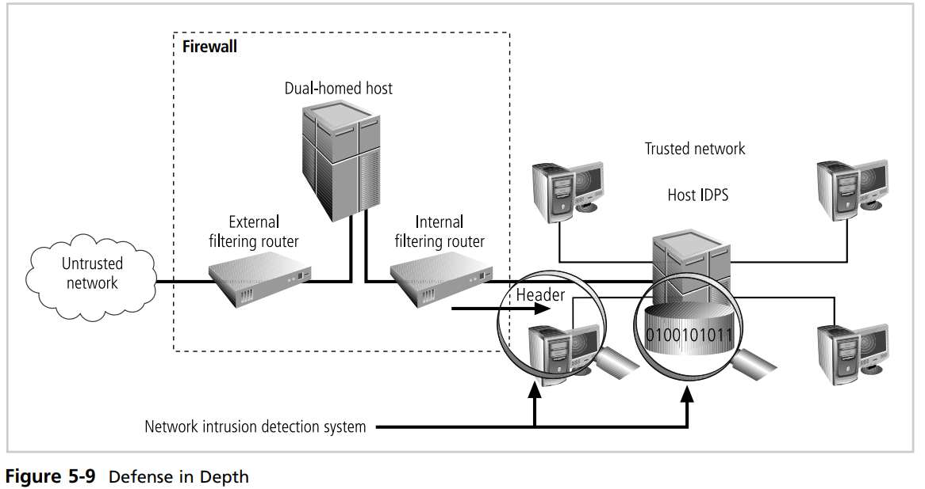
Design of Security Architecture

Slide 33
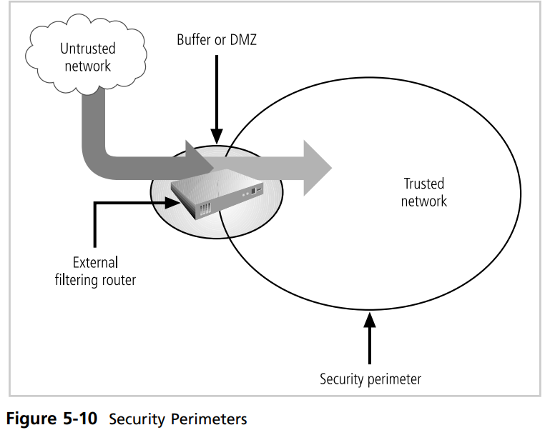
Design of Security Architecture

